Slide 1
INTRODUCTION
A dataset that estimated obesity levels based on the eating habits and physical condition of people from Mexico, Peru, and Colombia from UC Irvine’s Machine Learning Repository, which included the data of 2111 individuals ages 14 to 61.The dataset had 17 attributes, many of which have acronyms for ease of coding.

Slide 2
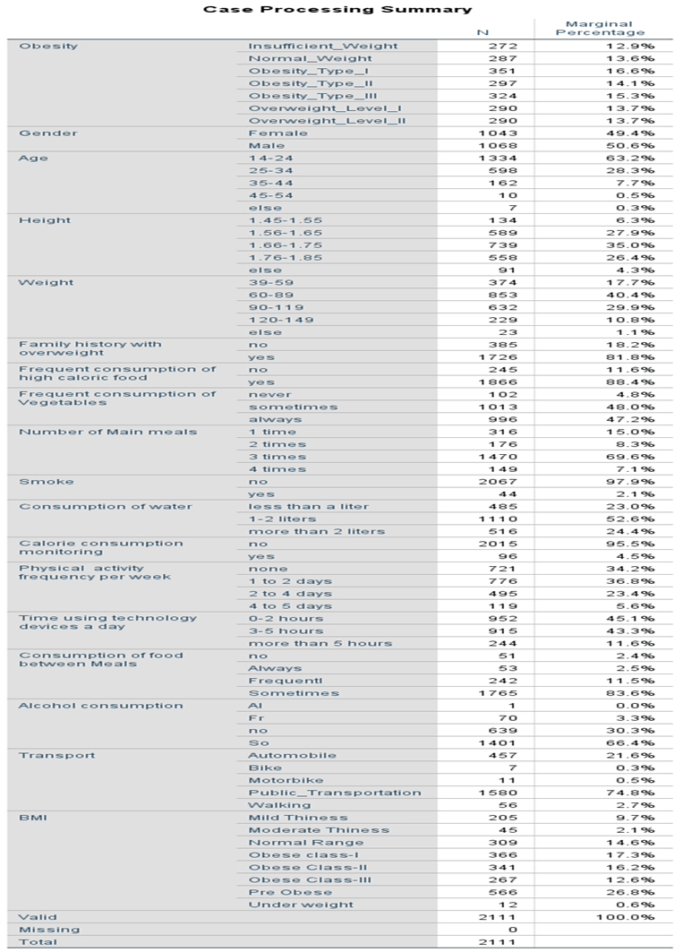
FEATURES 🡪
These classifications are usually formed with respect to body mass index (BMI), which gives a better look into the
relationships between these attributes and obesity which helps to include BMI as a column. This came out to be (2111, 18), which confirms that there are 2111 rows and that the BMI column was counted to make 18 columns, as there were 17 before.

Slide 3
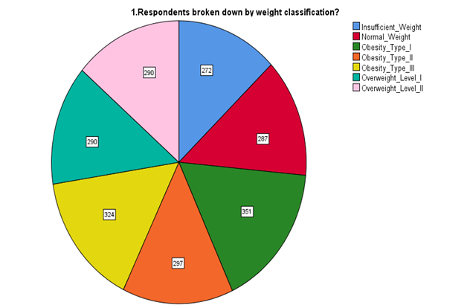
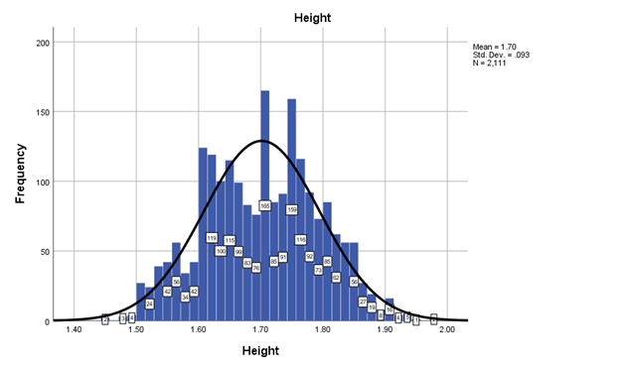
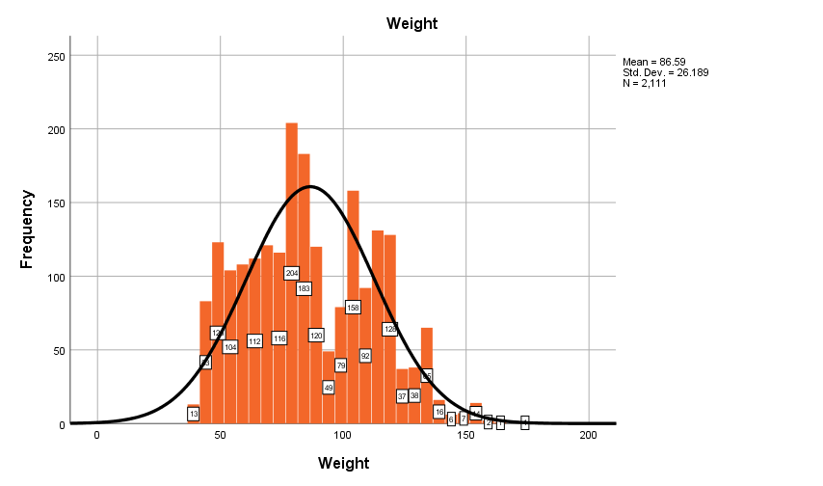
Graph1 shows us that the dataset is not very representative of the populations of Mexico, Peru, and Colombia, as all three countries have many more overweight people than obese people, yet this dataset is 40% obese and 25% overweight. Similarly, only 1.4% of Mexicans are underweight, yet people of insufficient weight account for more than 10% of this dataset.
Graph 2 and 3 shows Weight and height are integral to the estimation of a person’s weight classification, as they are the two variables in one’s BMI calculation. Neither variable is skewed toward a side.

Slide 4
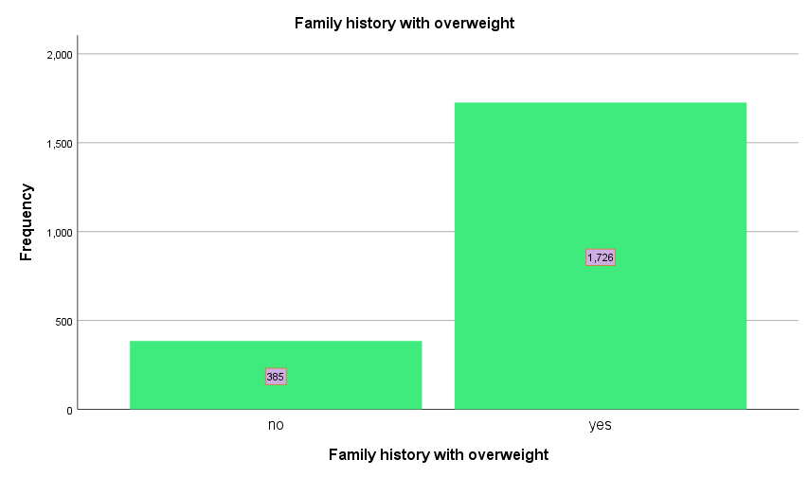
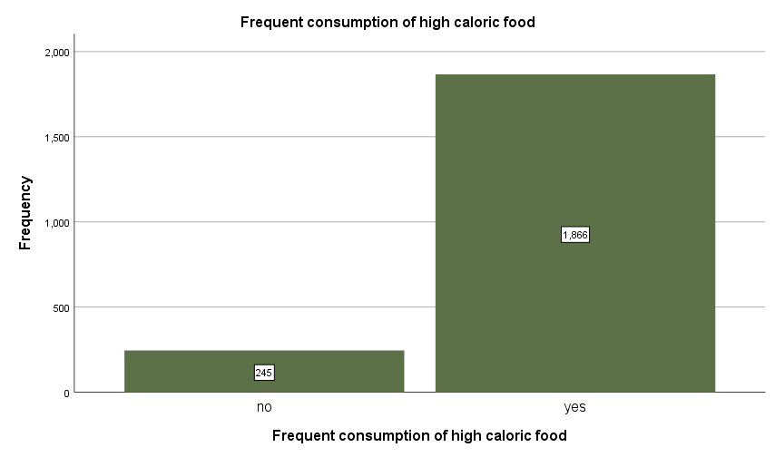
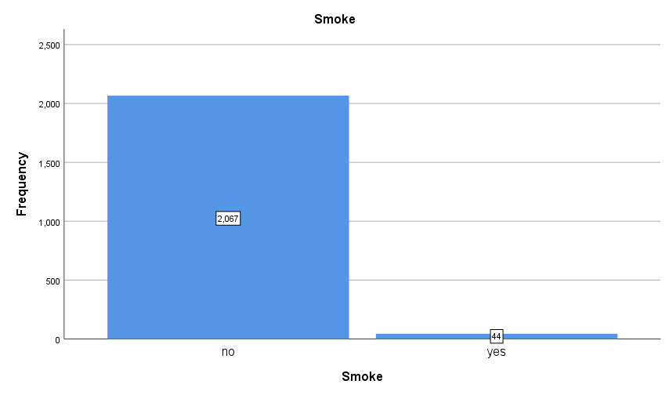
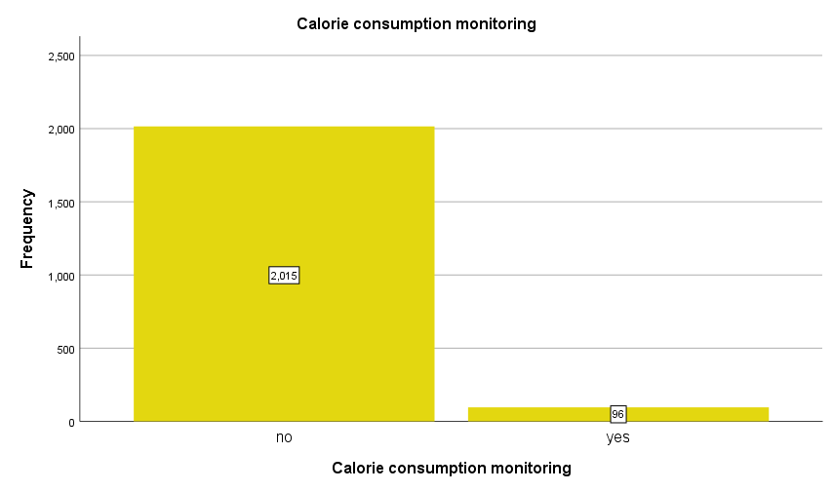
Graph 4-7 For example, smokers only account for 1% of the overall respondents, so it is helpful to keep the extremely sample size of smokers in mind when evaluating the effect of smoking on obesity. The same goes for evaluating the effect of calorie consumption, as less than 5% of respondents
A large majority of respondents have a family history of weight issues and consume high-calorie food often, so conclusions drawn from this data may be more accurate, but it is also important to consider that this data may also skewed towards a population that is more obese than average.

Slide 5
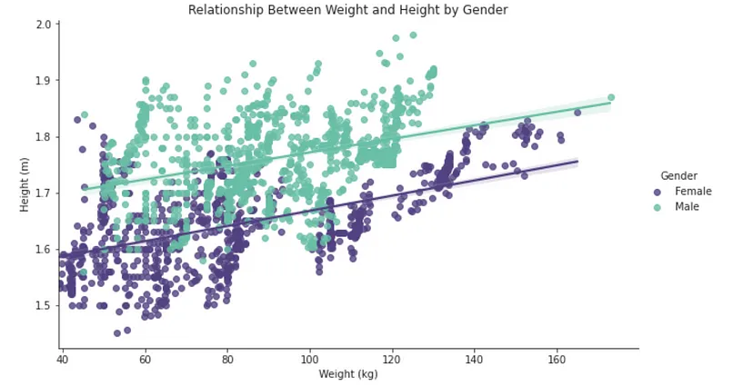
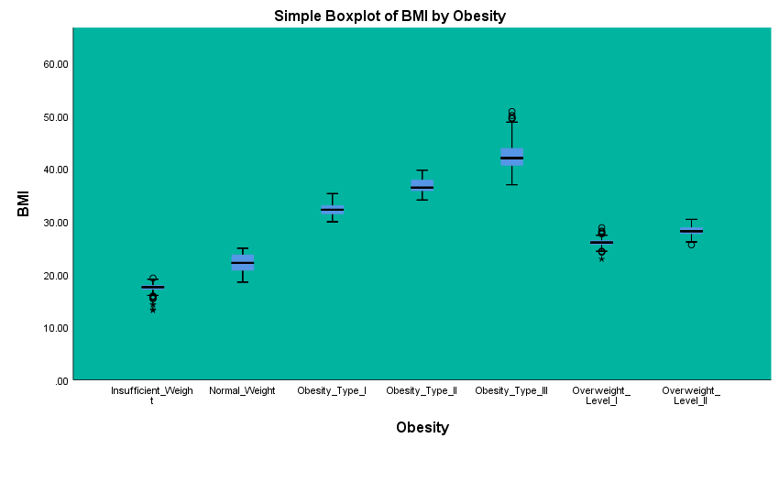
This graph-8 shows us there is a trending upwards relationship between weight and height with both genders, with the regression line for females slightly steeper than that of males, meaning that the same increase in weight for females corresponds to a slightly larger increase in height
The graph -9 has also not too many outliers, indicating that there is a strong correlation, so BMI can be used as a quantitative variable when evaluating the effect of different variables on weight category

Slide 6
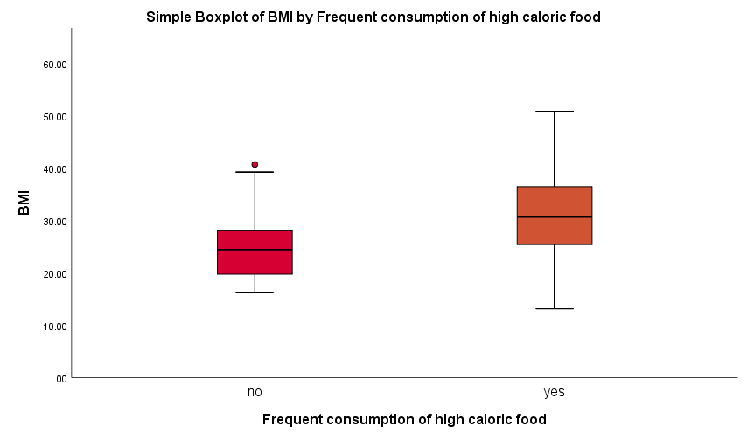
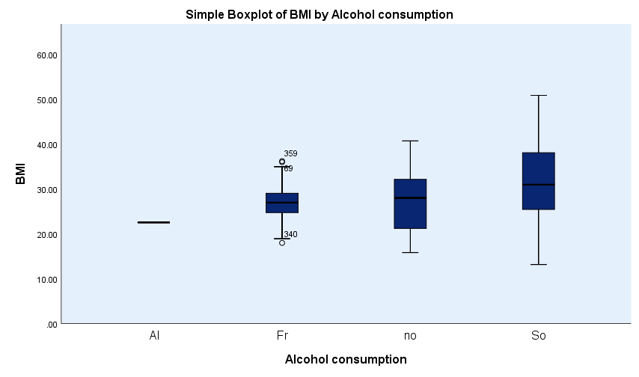
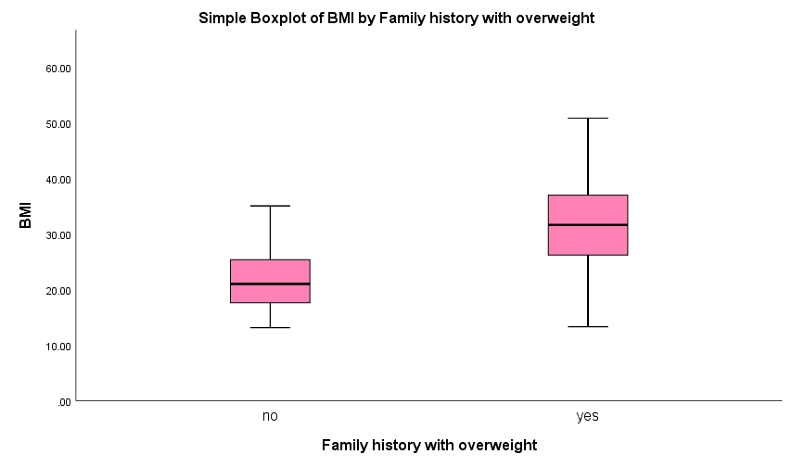
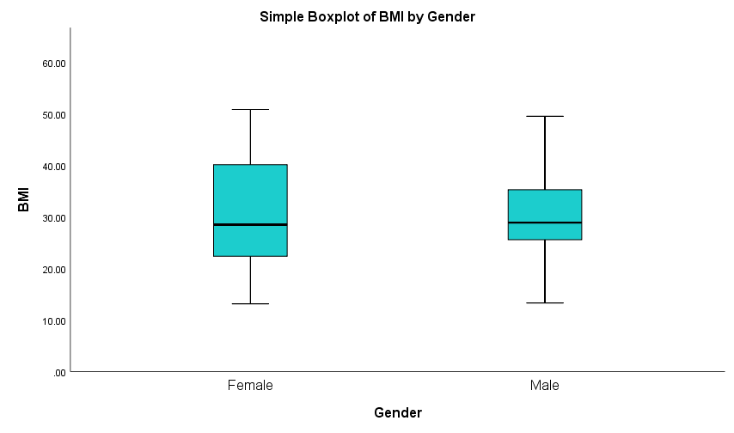

Slide 7
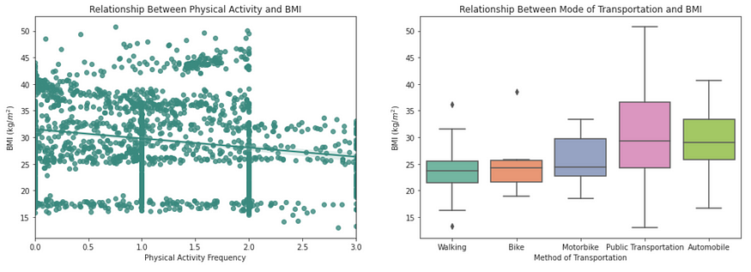
The first subplot illustrates how those that frequently consume high-calorie food have a median indicates that calorie count is likely a contributing factor to increased body fat
The third subplot suggests that a family history of obesity is also a contributing factor
Lastly, the fourth subplot does not show any relationship between gender and BMI as females and males had the same median
Graph 11 to 14
The second subplot shows that there is little relationship between alcohol consumption and BMI, as those who frequently drink alcohol had the same median BMI as those who do not drink alcohol at all
Graph 15 -16 Sorting them in this order shows us that there is a trend between more strenuous activity, such as walking or biking, with a lower BMI.

Slide 8
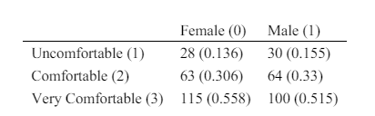
Ordinal regression is a statistical analysis method that can be used to model the
relationship between an ordinal response variable and one or more explanatory variables. An ordinal variable is a categorical variable for which there is a clear ordering of the category levels.
Ordinal logistic regression is an extension of logistic regression where the logit (i.e. the log odds) of a binary response is linearly related to the independent variables. If instead the response variable has k levels, then there are k-1 logits.
A major assumption of ordinal logistic regression is the assumption of proportional odds: the effect of an independent variable is constant for each increase in the level of the response. Hence the output of an ordinal logistic regression will contain an intercept for each level of the response except one, and a single slope for each explanatory variable.
Example dataset
Suppose that customers at a bedding store are asked to rate how comfortable they find a newly
engineered mattress on a scale from 1 to 3; 1 for uncomfortable, 2 for comfortable, 3 for very comfortable. The categorical explanatory variable of interest is the gender of the respondent; 0
for female, 1 for male. The simulated dataset consists of 400 total observations. Table 1 displays the number and proportion of participants within each gender responding with each of the rating
categories.)

Slide 9
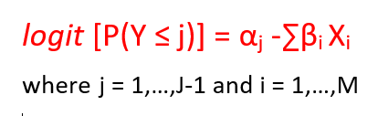
Assumptions
The dependent variable should be assessed using an ordinal scale, where categories exhibit a meaningful order but lack fixed intervals.
Independent variables can encompass a range of types, including continuous, categorical, or ordinal variables, depending on the research context.
It is essential to ensure that there is no multicollinearity among the independent variables. This method relies on the proportional odds assumption. It means that each pair of outcome groups shares the same association with the independent variables.
In practical terms, the coefficients describing the relationship between the lowest category of the dependent variable and all higher categories should be identical to those describing the relationship between the next lowest category and all higher categories, and so on.

Slide 10
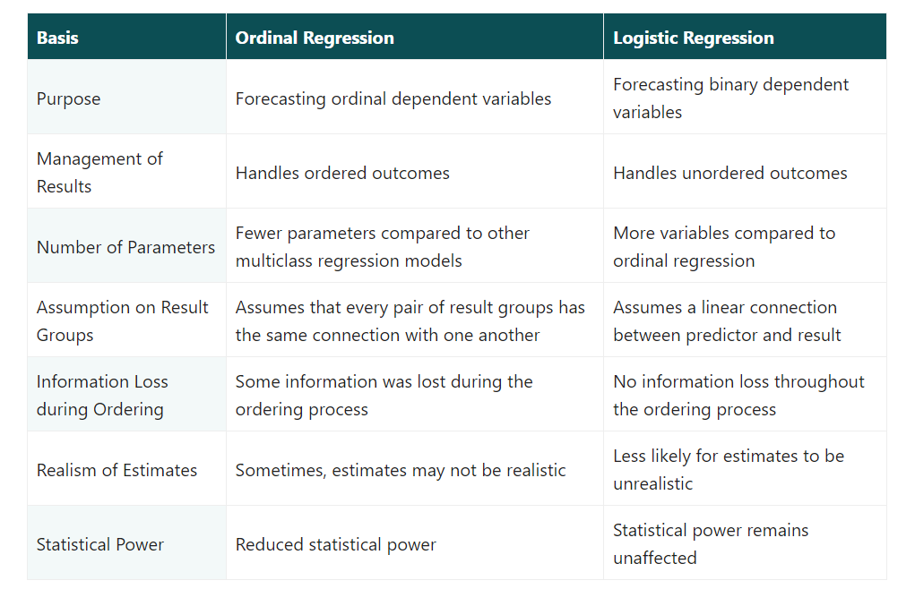

Slide 11
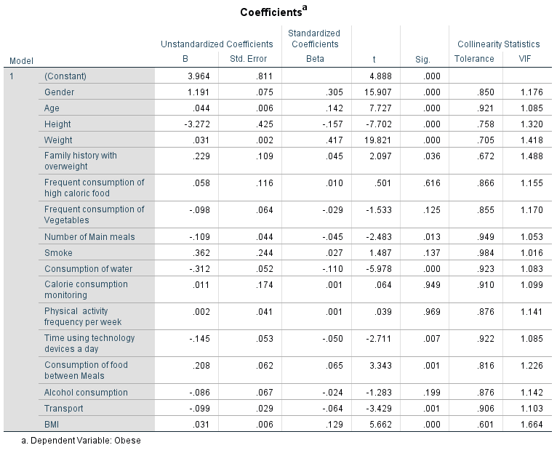
Assumption of Multicollinearity:
All the independent variables have VIF less than 5 which indicates no multicollinearity

Slide 12
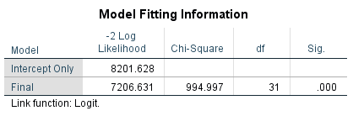
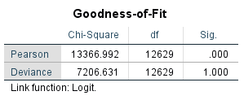
Base Model: Model with intercept only
Interpretations:
Null Hypothesis: There is no significant difference between the base line model and the final model
Since the p value is 0.000 which is less 0.05 we reject the null hypothesis which indicates there is a difference bw the baseline and final model
Null Hypothesis: The Observed data is having goodness of fit with the fitted model since the p value is 0.000 which is less 0.05 we reject the null hypothesis.

Slide 13
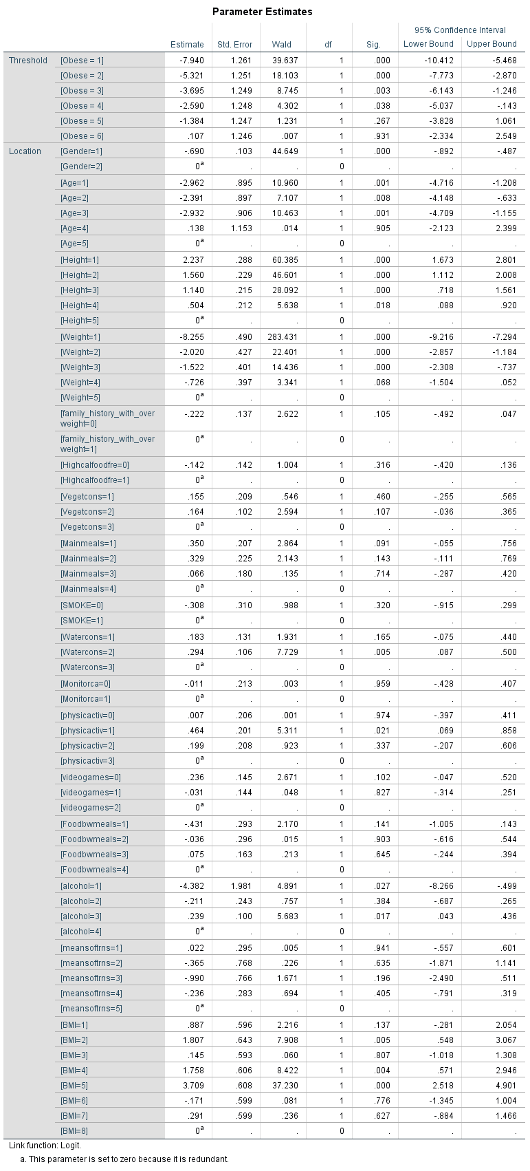
The following table can be interpreted as
Estimates shows the probability of a case falling above a given category on the dependent variable
The sign is interpreted as a linear regression
The + sign is associated with an increase likelihood of a case falling into the higher category of the dependent variable
The - sign is associated with an decreased likelihood of a case falling into the higher category of the dependent variable

Slide 14
Observations:
The variable “Gender” -1( female) was associated with a decrease of 0.690 falling into the higher category of the dependent variable
The “Age”-1 to 4 groups are associated with the decrease of 2.000 of falling into the higher category of the dependent variable
The height ranging from 1- 5 are associated with the positive sign out of which ,the group 1🡪 1.45-1.55 has a increase of 2.237 of falling into the higher category of the dependent variable
The weight group ranging from 1-5 are associated with the negative sign out of which ,the group 1🡪 1.45-1.55 has a decrease of 8.255 of falling into the higher category of the dependent variable
People with “Family History with overweight” as no has a decrease of 0.222 of falling into the higher category of the dependent variable
People who donot “High caloric consumption of food” is associated with a decrease of 0.142 of falling into the higher category of Dependent variable
The variable “Vegetable Consumption ” with the groups 1-3 is associated with a increase of falling into the higher category of Dependent variable

Slide 15
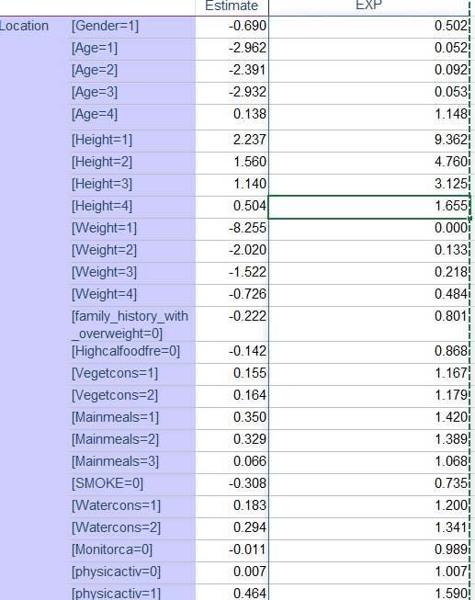
ODDS Ratio
The ODDS of female are 0.052 times of male of being fallen into the highest category of Obesity
The ODDS of age are increasing with increase in the estimate of predictor variable
The ODDS of people with the height 1.45-1.55 cm are 9.362 times of other heights being fallen into the category of Obesity
People who donot smoke have 1.389 odds than the people who smoke to be fallen under the category of the obesity

Slide 16
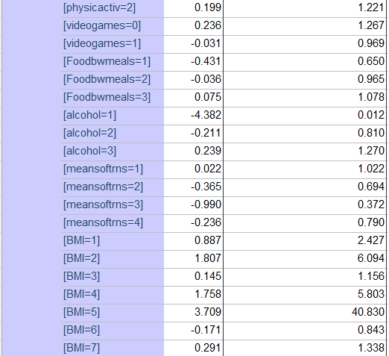
From the table the people with BMI -5🡪Obese class II has 97 % of probability of being categorized as Obese
There is 50% of probability for the people who travel in Automobiles might be categorized as Obese
There is 51% probability of people who consume food between meals frequently being categorized than other groups
There is 49% probability with people playing video games with 1-2 hours being categorized than the other groups

Slide 17
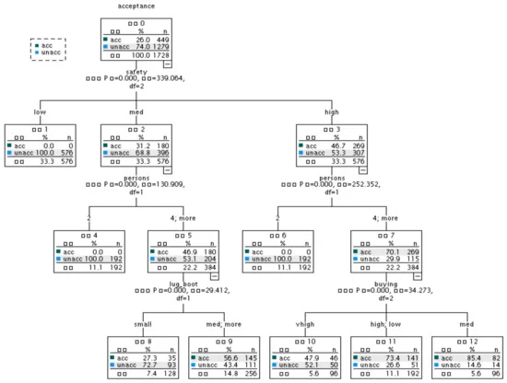
Decision Tress in SPSS
The CHAID method is optimal when the predictor variable is a categorical variable. For continuous variables, CHAID automatically divides the continuous variables into 10 segments, but there may be omissions.
The CHAID algorithm uses the chi-square detection method in statistics, and because of the chi-square detection method, CHAID has a good mathematical theoretical basis in branch calculation, and its credibility and its accuracy are relatively high.

Slide 18
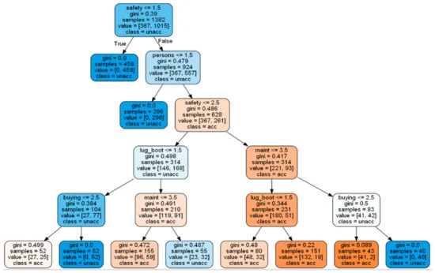
As for the CART (Classification and Regression Tree) algorithm, its segmentation logic is the same as that for CHAID, and the division of each layer is based on the test and selection of all independent variables.
However, the test standard used by CART is not the chi-square test, but the indicators of impurity, such as the Gini coefficient (Gini). The biggest difference between the two is that CHAID adopts the principle of local optimization, that is, the nodes are irrelevant to each other.

Slide 19
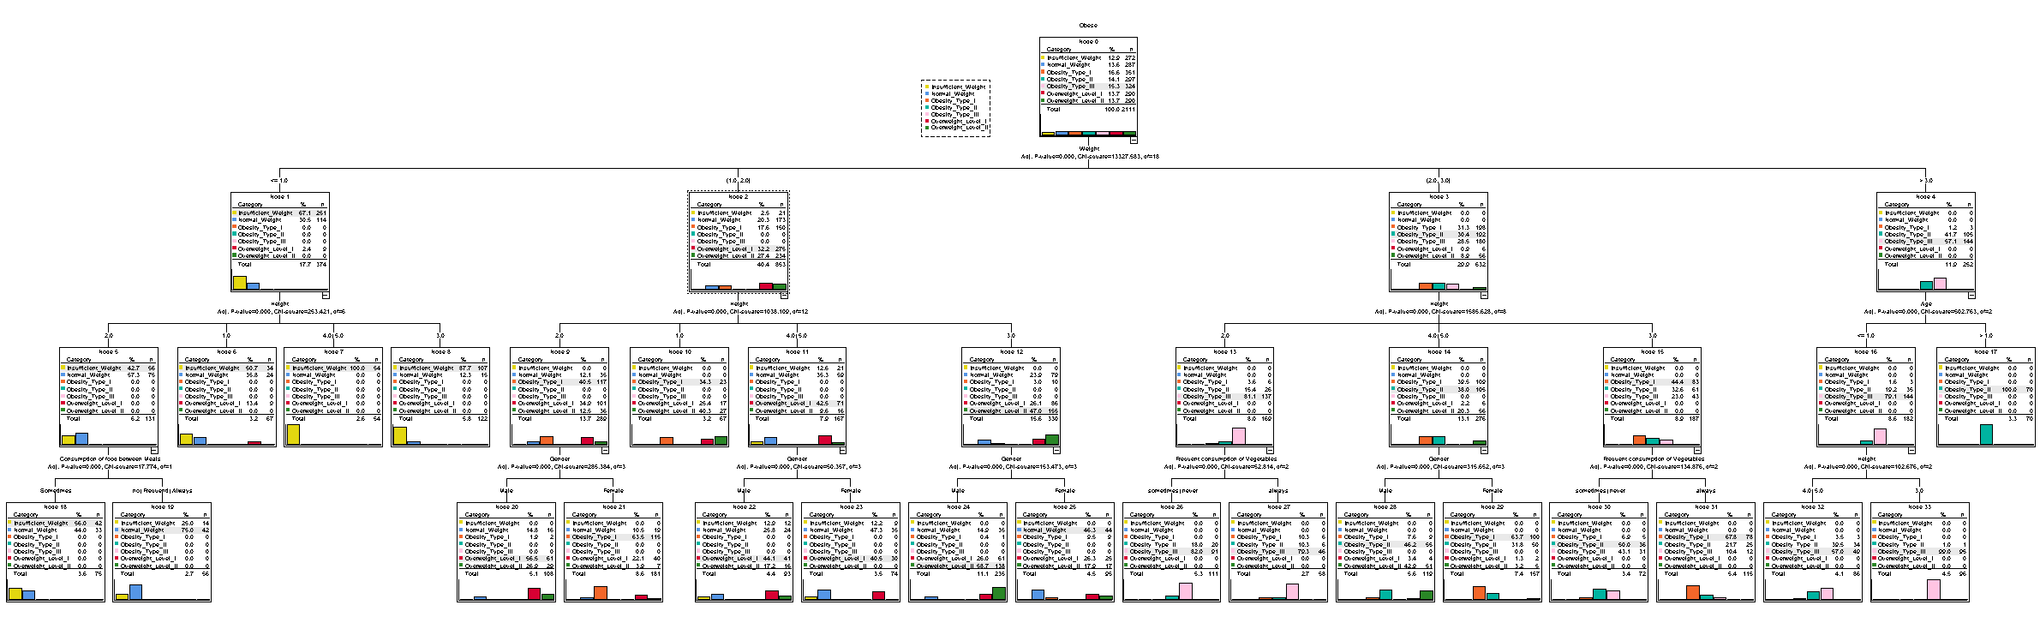
Decision Tree

Slide 20
Node 1-4
Node 5-8
Weight | Count | Category
39-59(1) | 251 | Insufficient Weight
People with weight 39-59,60-89 | 275 | Over Weight Level -I
People with weight 60-89,90-119 | 192 | Obesity Type -II
People with weight above 90-119 | 144 | Obesity Type -III
People Weight:39-59 under these Heights
Height | Count | Category
1.45-1.55(1) | 34 | Insufficient Weight
1.56-1.65(2) | 58 | Insufficient Weight
1.66-1.75(3) | 107 | Insufficient Weight
1.76-1.85(4) Else(5) | 54 | Insufficient Weight

Slide 21
Node 9-12
People Weight:60-89 under these Heights
Height | Count | Category
1.45-1.55(1) | 23 | Obesity Type -I
1.56-1.65(2) | 117 | Obesity Type -I
1.66-1.75(3) | 47 | Overweightlevel -II
1.76-1.85(4) Else(5) | 71 | Overweightlevel -I
Node 13-15
People Weight 90-119,120-149 under these Heights
Height | Count | Category
1.56-1.65(2) | 137 | Obesity Type -III
1.66-1.75(3) | 83 | Obesity Type-I
1.76-1.85(4) Else(5) | 105 | Obesity Type -II

Slide 22
Node 16-17
People Weight:60-89 under these Age
Age | Count | Category
14-24(1) | 144 | Obesity Type -III
>14-24(2) | 70 | Obesity Type -II
Node 18-19
People Weight:39-59 with height 1.56-1.65 with consumption of food between meals
Height | Count | Category
Sometimes(4) | 42 | Insufficient weight
No,Frequently,always(3,2,1) | 42 | Normal Weight

Slide 23
Node 20-21
People Weight 39-59,60-89 with height 1.56-1.62 for Gender
Gender | Count | Category
Female(1) | 115 | Obesity Type -I
Male(2) | 61 | Overweight level -I
Node 22-23:People Weight 39-59,60-89 with height 1.76-1.85 and else for Gender
Gender | Count | Category
Male(2) | 41 | Overweight level -I
Female(1) | 30 | Overweight level -I

Slide 24
Node 24-25
People Weight 39-59,60-89 with height 1.66-1.75 for Gender
Gender | Count | Category
Female(1) | 44 | Normal Weight
Male(2) | 138 | Overweight level -II
Node 26-27 :People Weight 60-89,90-119 with height 1.56-1.65 for Frequent Consumption of vegetables
Frequent Consumption of Vegetables | Count | Category
Sometimes | 91 | Obesity Type -III
Never,Always | 46 | Obesity Type-III

Slide 25
Node 28-29:People Weight 60-89,90-119 with height 1.76-1.85 and else for Gender
Gender | Count | Category
Female(1) | 100 | Obesity Type _1
Male(2) | 55 | Obesity Type-II
Node 30-31:People Weight 60-89,90-119 with height 1.66 -1.75 for Frequent Consumption of vegetables
Frequent Consumption of Vegetables | Count | Category
Sometimes | 91 | Obesity Type -III
Never,Always | 46 | Obesity Type-III

Slide 26
Node 32-33:People with age 14-25 with height 1.76-1.85 and else
Height | Count | Category
1.66-1.75(3) | 95 | Obesity Type-III
1.76-1.85(4) Else(5) | 49 | Obesity Type -III

Slide 27
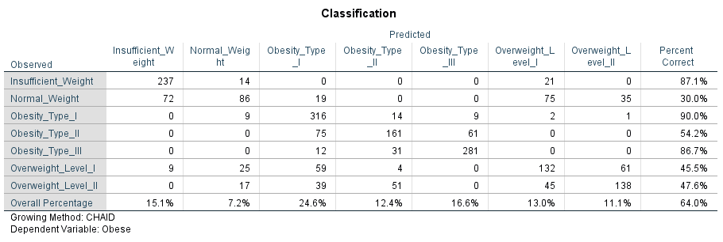
Classification Table:

Slide 28
Conclusion:
This project used the CHAID (Chi-squared Automatic Interaction Detection) method to classify individuals into various obesity levels based on health and lifestyle attributes.
Highest Classification Accuracy was achieved for:
Obesity_Type_I (90%)
Insufficient_Weight (87.1%)
Obesity_Type_III (86.7%)
Lowest Accuracy was seen in:
Normal_Weight (30%)
Overweight_Level_I (45.5%)
Overweight_Level_II (47.6%)
Overall Model Accuracy: 64%
Indicates moderate performance.
Could be improved by refining features or using ensemble models.

